Slide 1
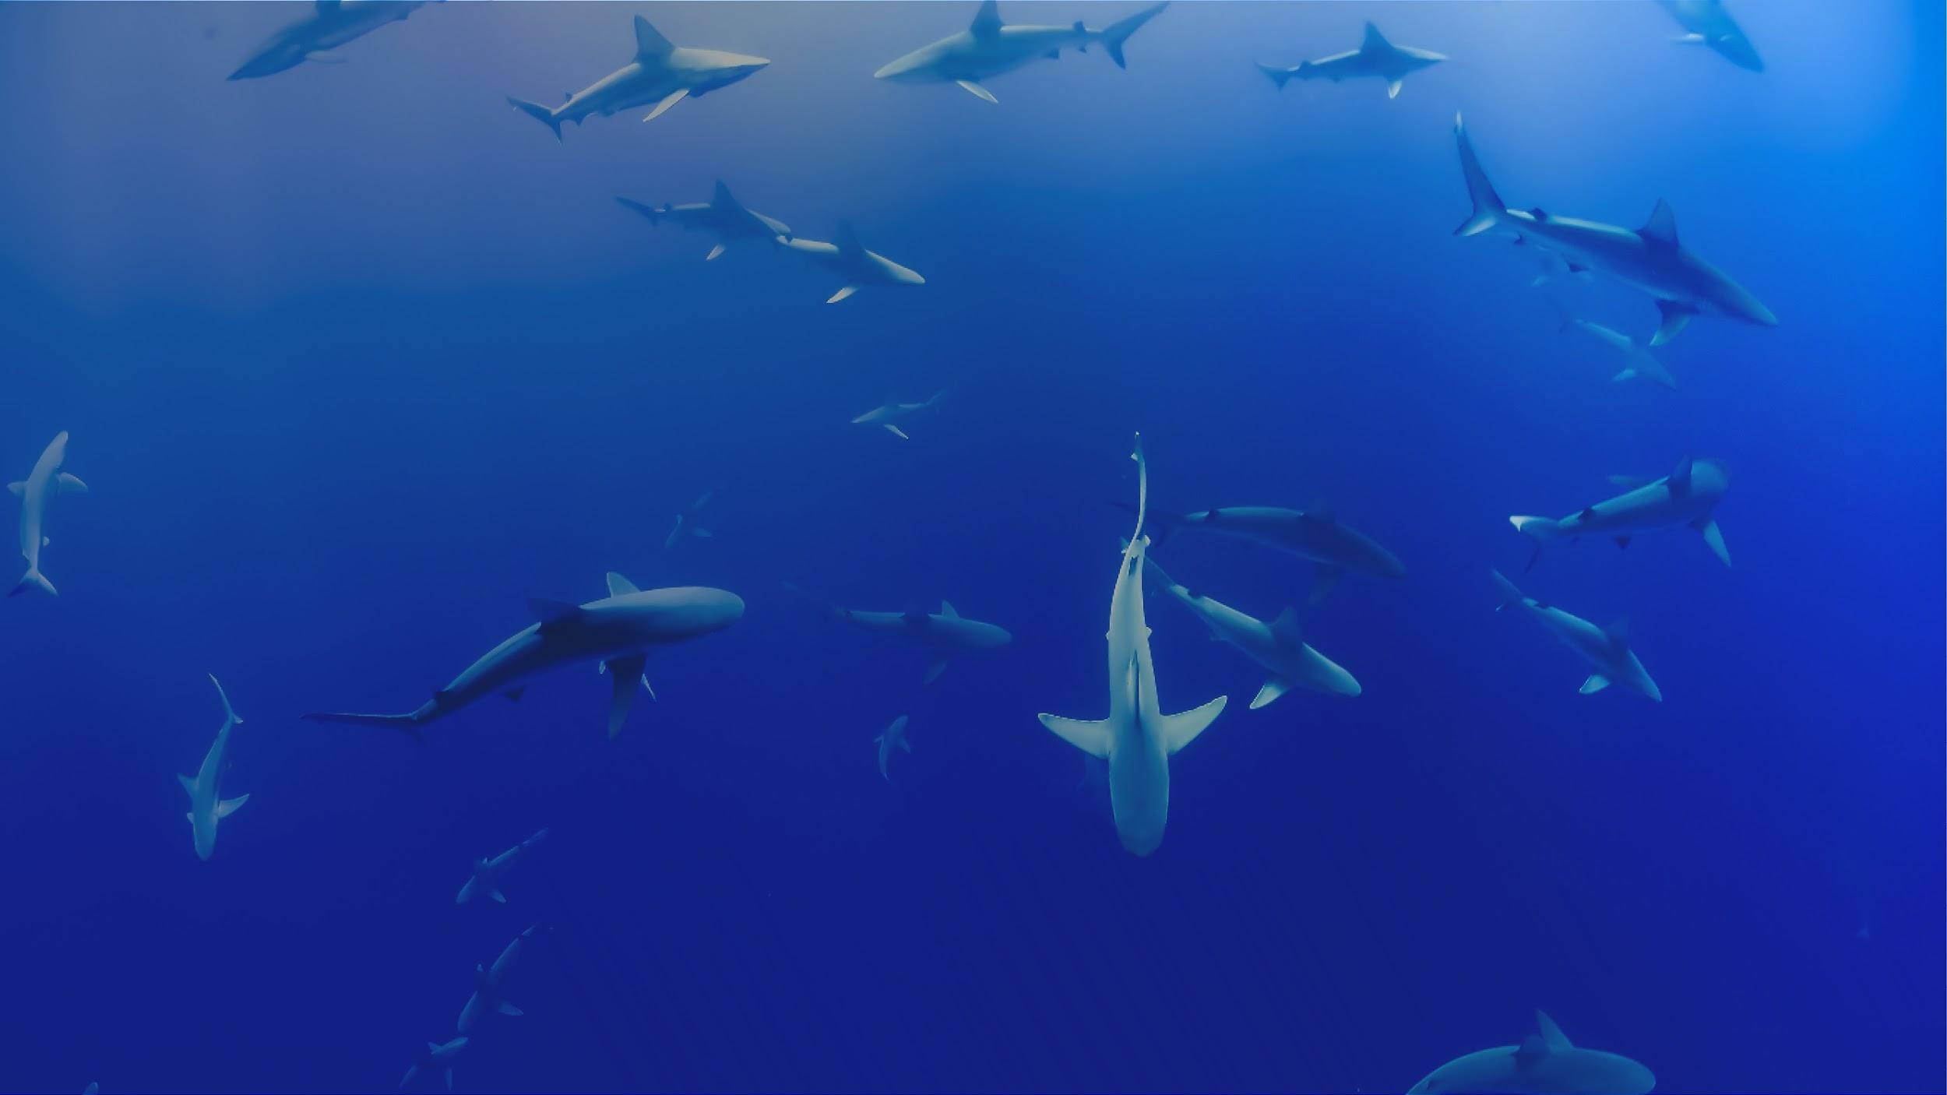


More Ways to Contribute to OBIS
Jon Pye, Brian Jones, Naomi Tress
Ocean Tracking Network Data Centre
Notes:
So now that we’ve worked in the ecosystem a little bit, and hopefully we’re on board with the general mission of OBIS and want to see it succeed, let’s talk about some of the indirect ways you might be able to support this initiative.

Slide 2
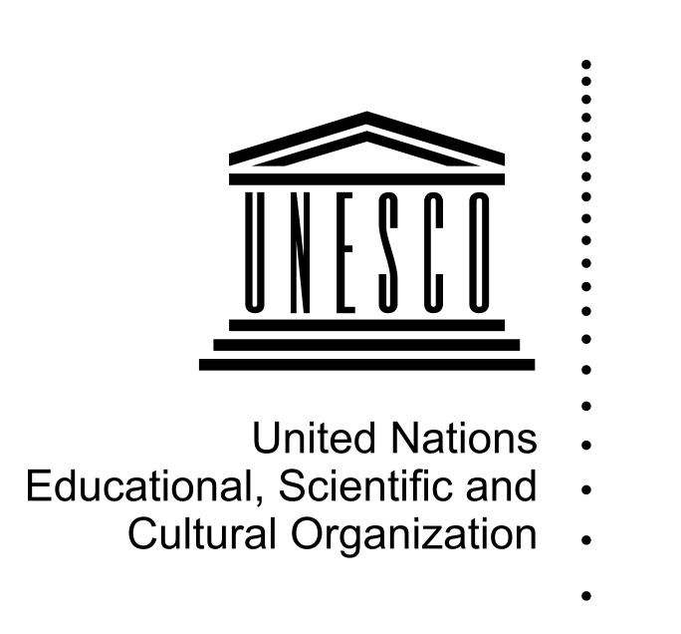

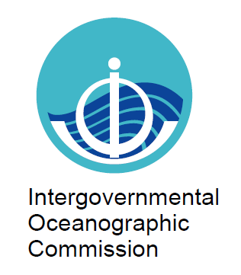









Notes:
As we’ve explored during the week, OBIS is a concept that is sustained and empowered by the efforts of a network of organizations, an assemblage of institutions that build data sharing software, design and maintain complex data systems, work out and evolve biological data standards and controlled vocabularies, and work within their areas of authority or expertise to produce datasets that conform to those standards and vocabularies.

Slide 3
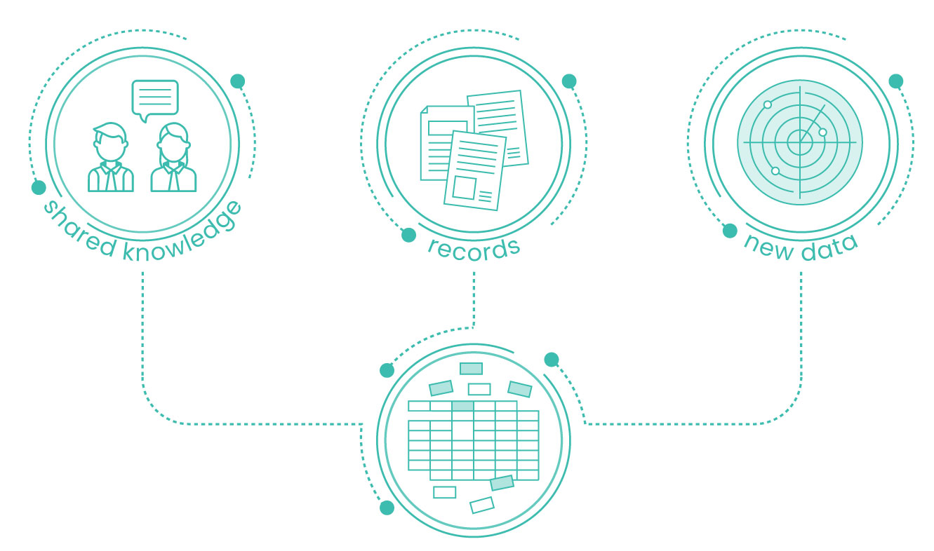
As a Data
Contributor
Collection:
Contributions to your national OBIS node both ongoing and historical
Notes:
So most of our focus this week is to increase your comfort level with identifying DarwinCore terms that match your data, and to work through some of the QC that OBIS requires, to make it easier for you to be a data contributor, for the data you collect in the future and perhaps also the historic data that may not have made it into publication yet. Going back into older datasets and surfacing them and making them fit for publication can be very valuable work, and as we’ve seen with some of the use cases, that historic data can be given the context required to support analyses and meta-analyses outside its original mandate.

Slide 4
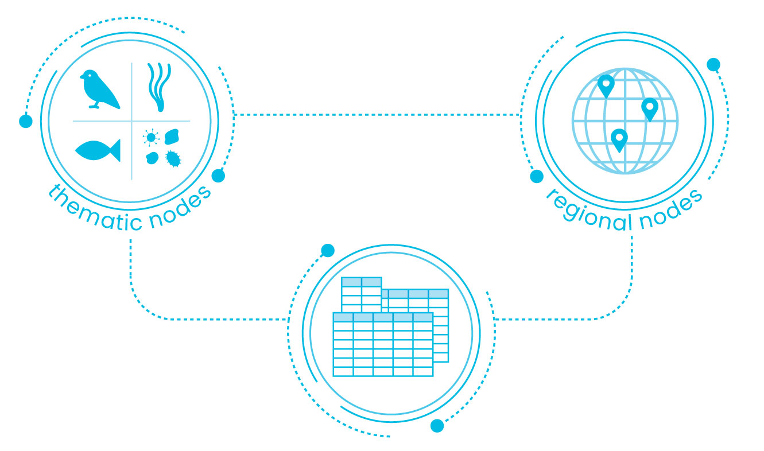
As a Data Curator
Curation:
Records currently in OBIS and OBIS Canada can be reviewed and revised to pass more of the QC checks OBIS conducts.
Subject matter expertise is irreplaceable for performing this work
Notes:
There will always be more work to do in tidying up the data that’s already in OBIS, and while I believe OBIS Canada’s in fairly good shape, reviewing the data we find there and ensuring it is in good shape smooths the pathway for that data to be considered by analysts using OBIS data. Your expertise may make you unique in spotting some of the finer points, so I would recommend browsing around datasets and trying to use them if that’s something that you might enjoy doing. You’d be doing a service to all who come after you.

Slide 5
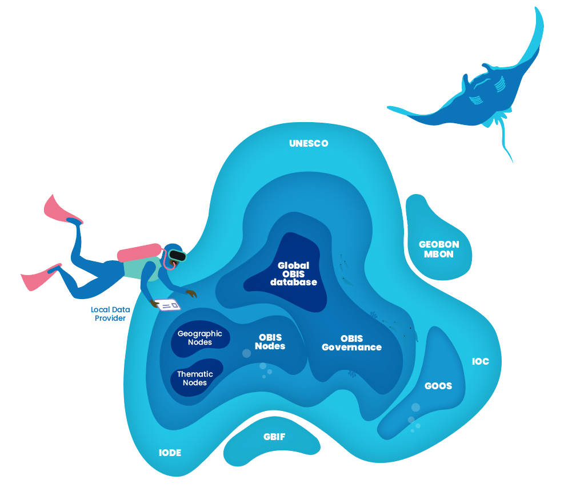
As a Software Developer
GBIF maintains the IPT @ github.com/gbif/ipt/
The robis and obistools packages : github.com/iobis
Implementations of OBIS/WoRMS API in other languages
Notes:
The IPT software is built as a Java Tomcat application, and has a small but dedicated developer base working on GitHub under the banner of the Global Biodiversity Information Facility. When we find problems and issues we can report them there, but if we’re experienced in building Tomcat apps, there is an opportunity there to pitch in and help develop the IPT to serve our purposes better.
The robis and obistools packages are developed by the OBIS project office, and are maintained on GitHub as well, and here I can tell you that you and a friend could double the number of developers working on these tools in R.
And if you’re not an R developer, say you are like me and prefer to work in Python, there are opportunities to implement things like robis or obistools in the language of your choice and bring another language the ability to check data and metadata and retrieve data records from OBIS quickly and easily.

Slide 6
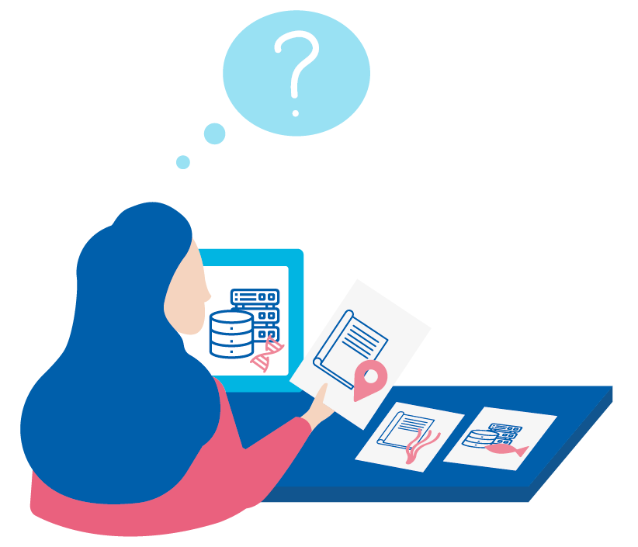
As a WoRMS Taxonomic Expert
Experts in taxonomy make WoRMS what it is.
An updated taxonomic reference with historic accepted names allows us to reference new and old taxonomic classifications at once
As with so many open data efforts, reliant on the volunteer work of experts like you
We can’t do what we do without…
Notes:
And we saw on the first day that our world registry of marine species relies on taxonomic experts around the globe to ensure the accuracy and currency of the taxonomic definitions their API returns. There may be only a few people in the world capable of performing this work for a certain taxonomic group, and if you’re one of those people I can’t imagine there’s a better opportunity to help maintain this critical part of the biodiversity data management ecosystem.

Slide 7
A healthy ocean is a diverse ocean
Recreational space
Resources (e.g. medicine nutrition, transport)
Our ocean provides essential services to humankind
Bio-geo-chemical planetary processes
Ocean diversity
Notes:
Our ocean provides essential services to humankind, and we all know that a healthy ocean teeming with life will support and enhance people’s lives and livelihoods.

Slide 8
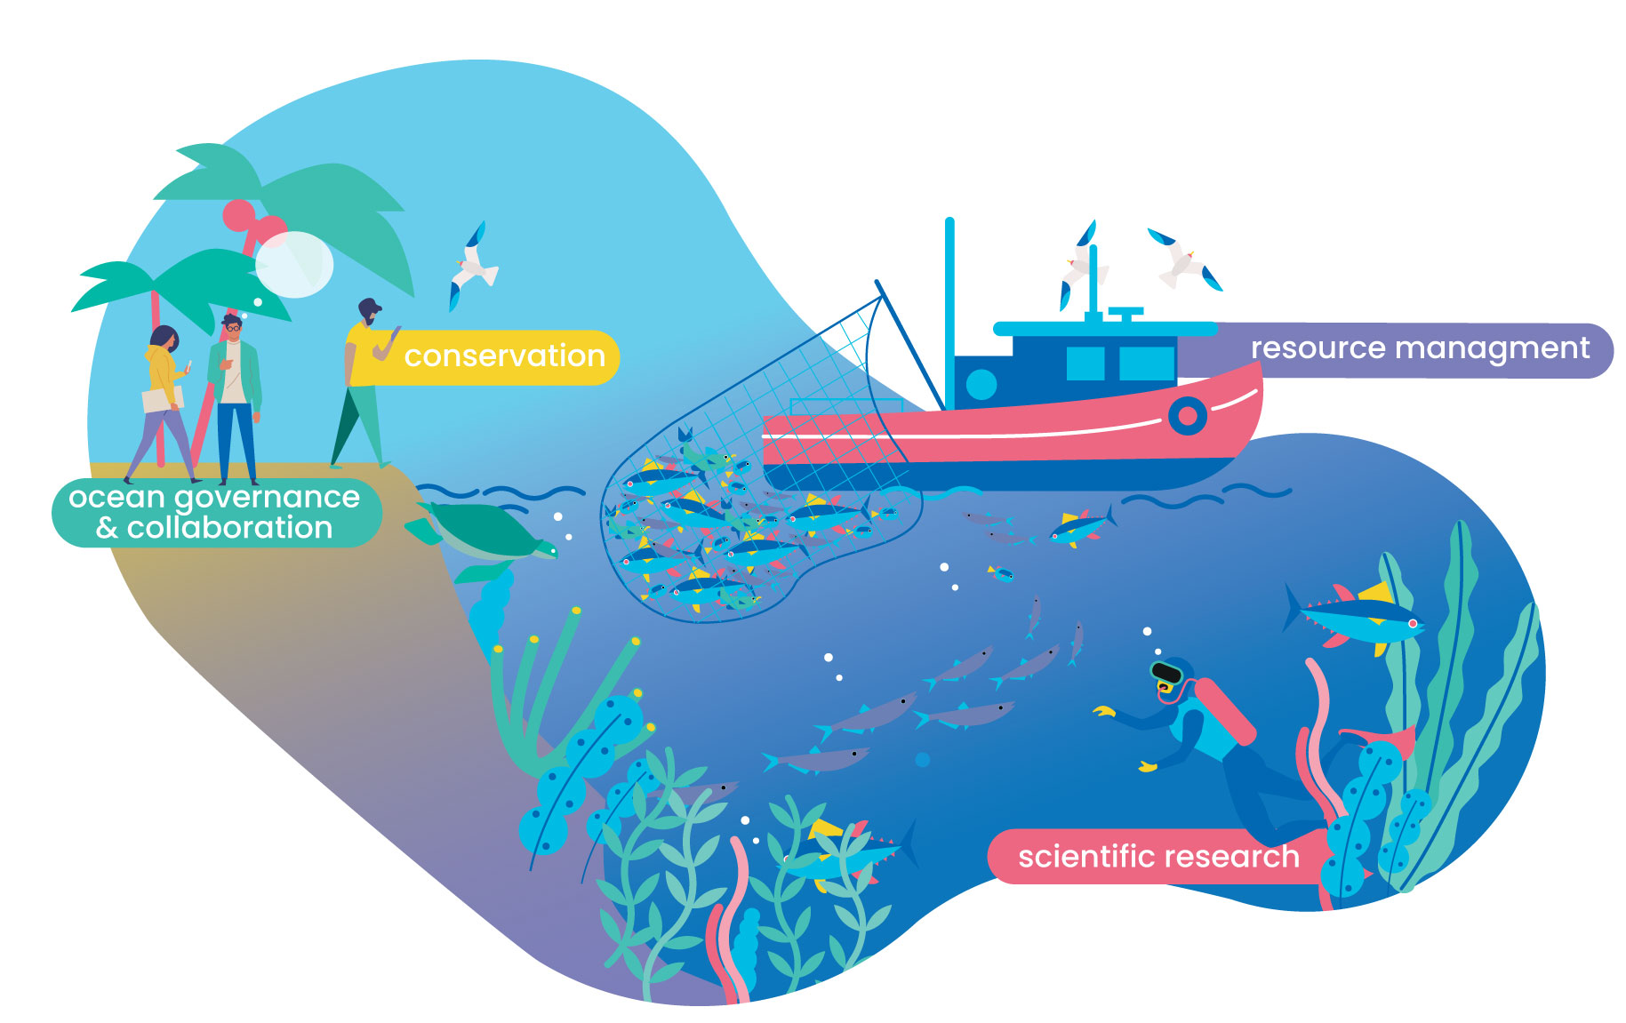
Sound scientific ocean management and conservation
starts with comprehensive biodiversity and biogeographic data
Notes:
However, our oceans’ biodiversity continues to be threatened and to counter global environmental issues and ensure the sustainable use of marine resources, we need data-driven research to inform conservation and ocean management.

Slide 9
Collect, analyse, archive, repeat
… but accessing such data requires extraordinary efforts from individual users to gather and assemble disjunct pieces of information.
A wealth of data about various marine species, habitats and whole ecosystems already exists,…
Notes:
A lot of data already exist, but the challenge lies in finding, accessing and making sense of the myriad of existing, but dispersed pieces of data.

Slide 10
OBIS:
Free, accessible and detailed marine data
Notes:
For 20 years now, OBIS has been building a central global platform that provides free access to the world’s ocean biodiversity and biogeographic data.

Slide 11
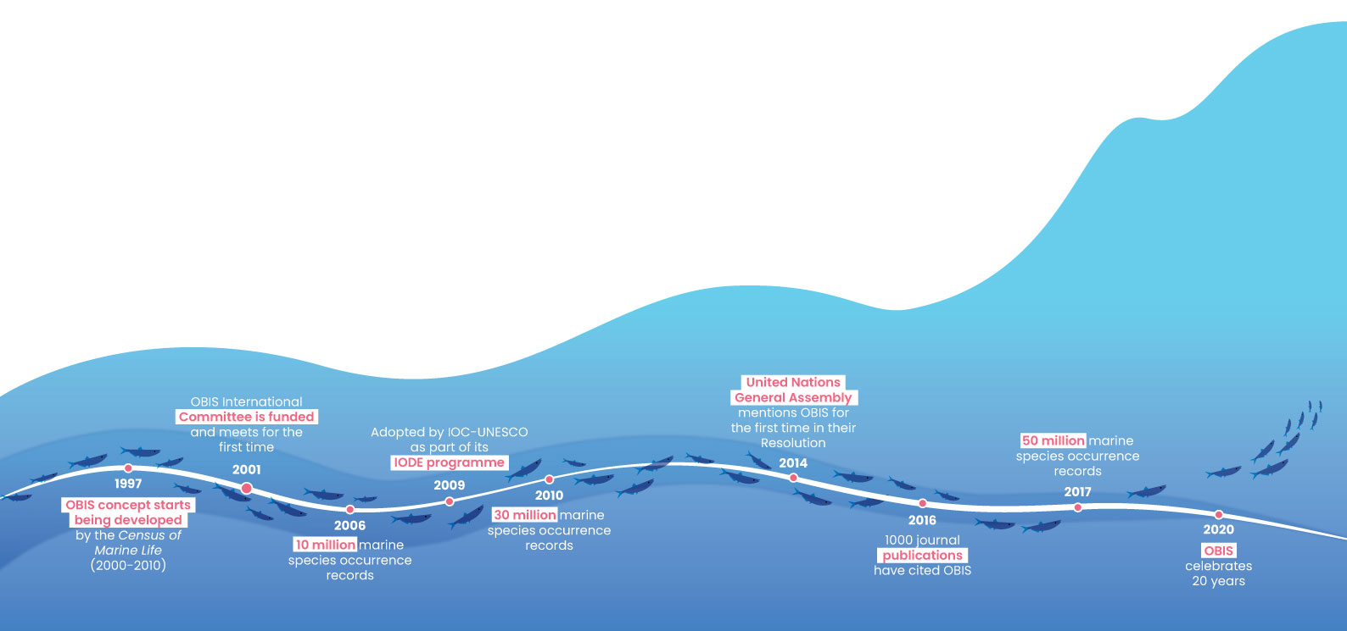
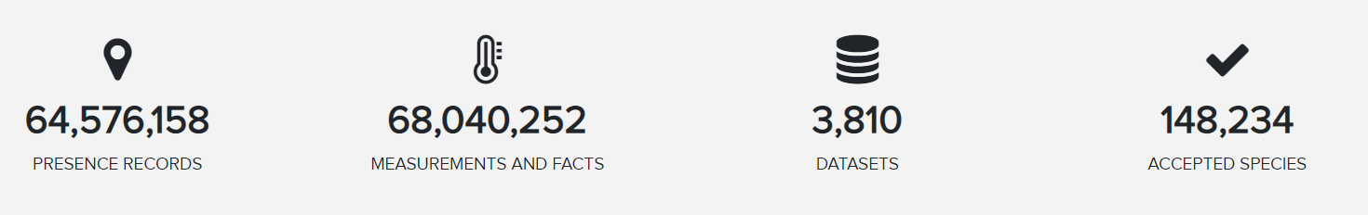
OBIS - Origins, history and achievements
Notes:
OBIS emanates from the Census of Marine Life. In 2000, when OBIS received its first funding the press release reported that “the ultimate vision of OBIS was that of an individual selecting any area or volume of water on a global map to bring up information on what has been reported to live there. OBIS would enable access by scientists and others to historical data on species distribution and abundance and provide a framework into which newly collected data can be placed”. [click] Today, OBIS integrates over 60 million presence records from 3691 datasets of nearly 150,000 marine species. And to give you an idea, this year they added 6 million records from 574 new datasets. That is more than 1 new dataset per day. Interestingly, the number of biotic and abiotic measurements and sampling facts now surpasses the amount of occurrence records.

Slide 12
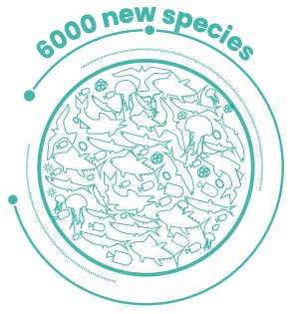
Census of Marine Life
Between 2000 and 2010 the multimillion-dollar initiative saw collaborative and individual efforts from more than 2700 scientists and more than 80 nations, putting the discipline of marine science on the map, discovering more than 6000 new marine species and highlighting some of the most urgent threats to our oceans.
2000
2010
Notes:
The Census of Marine Life (2000-2010) – a multimillion-dollar initiative – represented the first collaborative efforts from more than 2700 scientists and 80 nations to strengthen our understanding of our ocean. And in fact, the initiative discovered more than 6000 new marine species, put the discipline of marine science on the map and highlighted the most urgent threats to our ocean.

Slide 13
OBIS: Free, accessible and detailed marine data
But beyond this OBIS promotes a culture of cooperation by supporting training and capacity development.
At its core, OBIS operates as a rich database on marine life, rooted in international collaboration. OBIS data is used to tackle common challenges that concern the marine environment.
Notes:
Realizing its importance, governments assumed the responsibility for OBIS, when the Member States of the Intergovernmental Oceanographic Commission (IOC) of UNESCO adopted OBIS in 2009, and OBIS became a project of the International Oceanographic Data and Information Exchange (IODE) program.
OBIS operates as a collaborative network of regional and thematic nodes and the global OBIS network promotes a culture of cooperation and supports training and capacity development, while also maintaining partnerships around the globe, with organisations such as the Marine Biodiversity Observation Network (MBON), the Global Ocean Observing System (GOOS) and the Global Biodiversity Information Facility (GBIF).

Slide 14

OBIS
Data life cycle
Notes:
Globally, a lot of human and financial resources have been and are being invested into the collection of a vast amount of biodiversity data ranging from records of small microorganisms to megafauna, from the tropics to the poles and from the surface to the deepest trenches. The nearly 65 million records in OBIS is a compilation of this diversity.

Slide 15
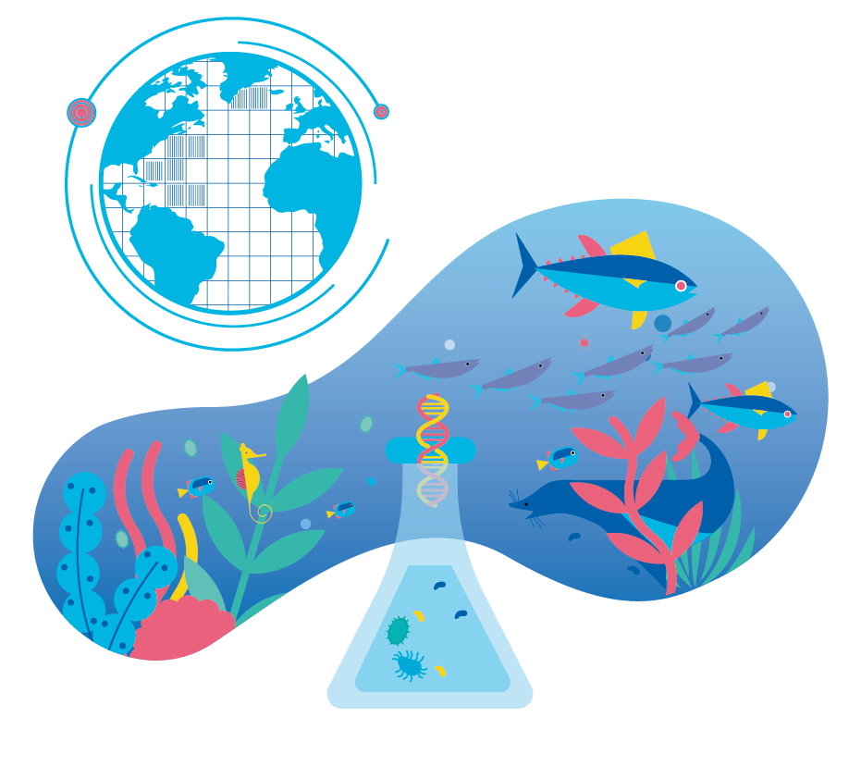
From Nature to Numbers
Presence/Absence data
can originate from sporadic sightings or novel detection methods such as environmental DNA. This quantitative data allows the establishment of species ranges.
Notes:
The core of OBIS are the PRESENCE and ABSENCE DATA. These records can represent point locations, but can also be part of line transects from trawling, or polygons, or even a point in a grid for cases where the exact location cannot be disclosed.

Slide 16
From Nature to Numbers
Abundance data
represents the number of individuals of a species in a given area or volume of seawater or sediment. This is a key metric for the conservation of vulnerable organisms and the management of species populations like fish stocks.
Notes:
From its inception, OBIS has also ingested ABUNDANCE DATA, which represents the number of individuals of a species in a given area or volume of sea water or sediment. This is a key metric for the conservation of species and the management of species populations like fish stocks. Because the Impact of environmental change will happen first at the abundance level, and may not be detected immediately in species presence/absence data.

Slide 17
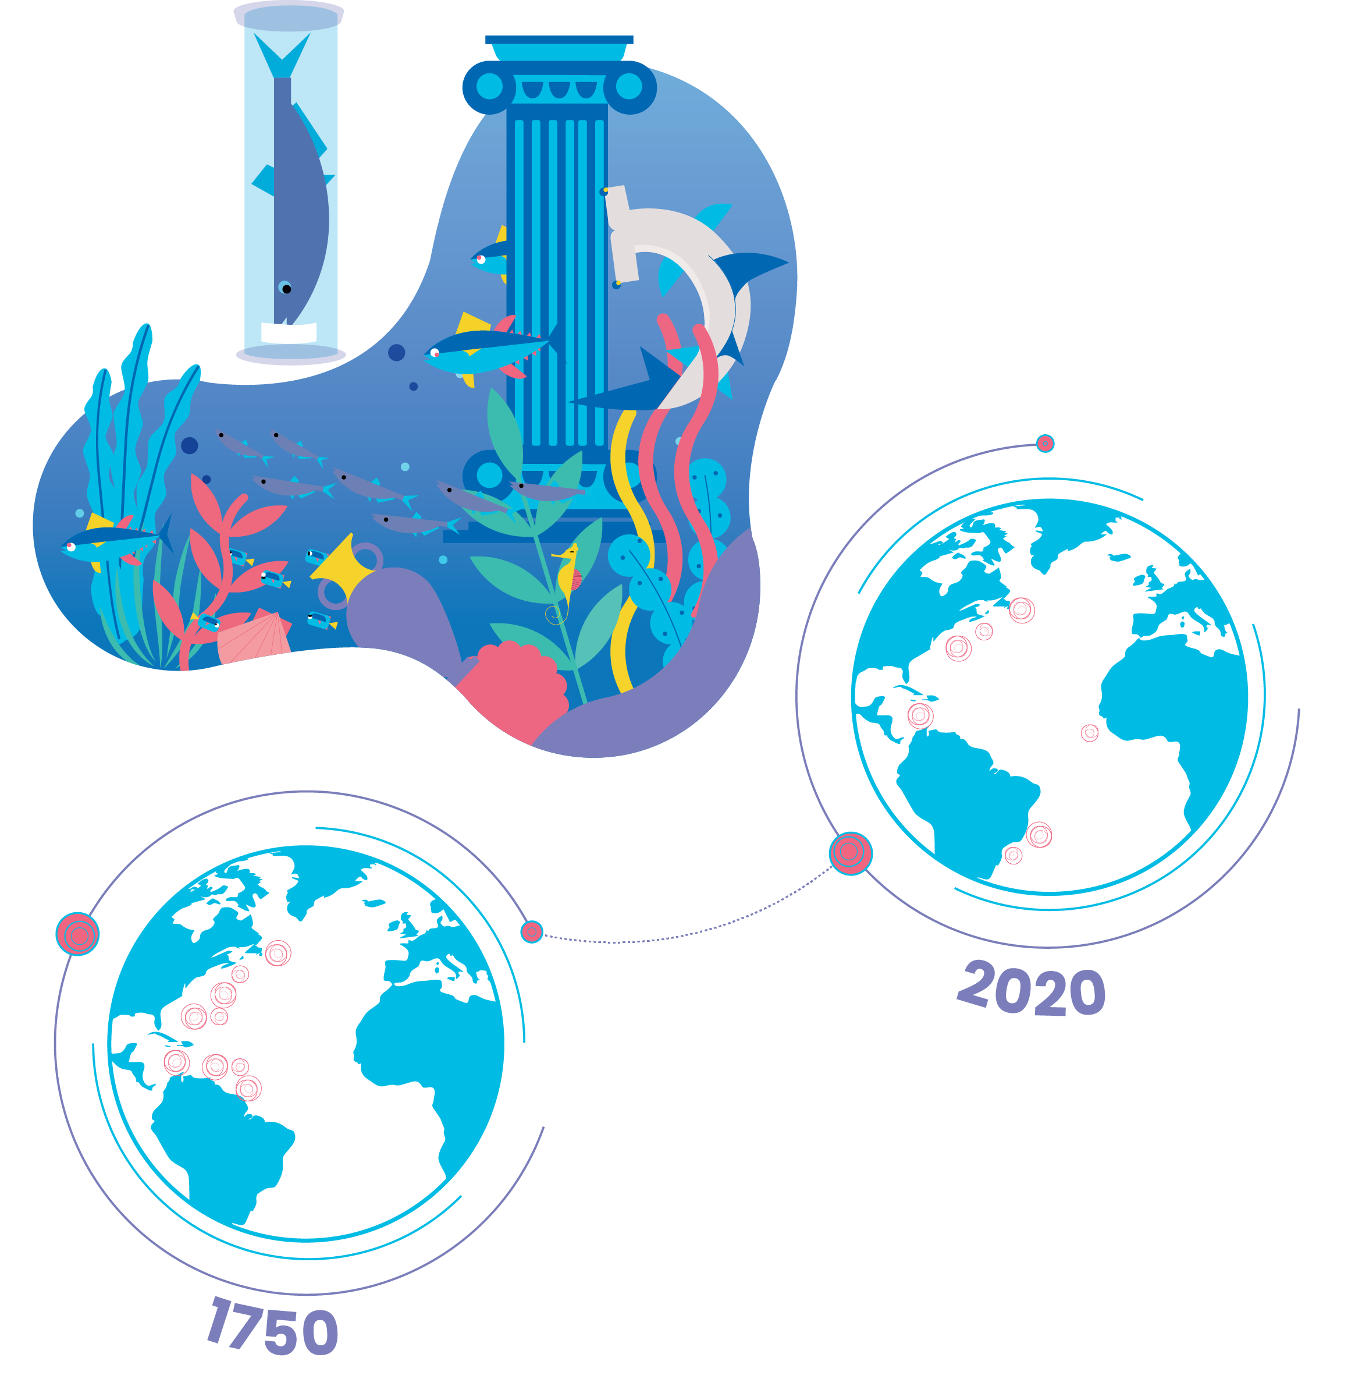
From Nature to Numbers
Historical data
characterises historic records and findings preserved in archives, libraries and older data series which enable comparative analysis over time.
Notes:
Half of the data in OBIS (about 30 million records) are from sampling events before 2000 (when OBIS started) and we have 4 million records from before 1970. So a lot of our efforts have focused on digitizing historic records preserved in archives, libraries, museum collections. These older data provide us an important baseline that enables comparative analysis over time.

Slide 18
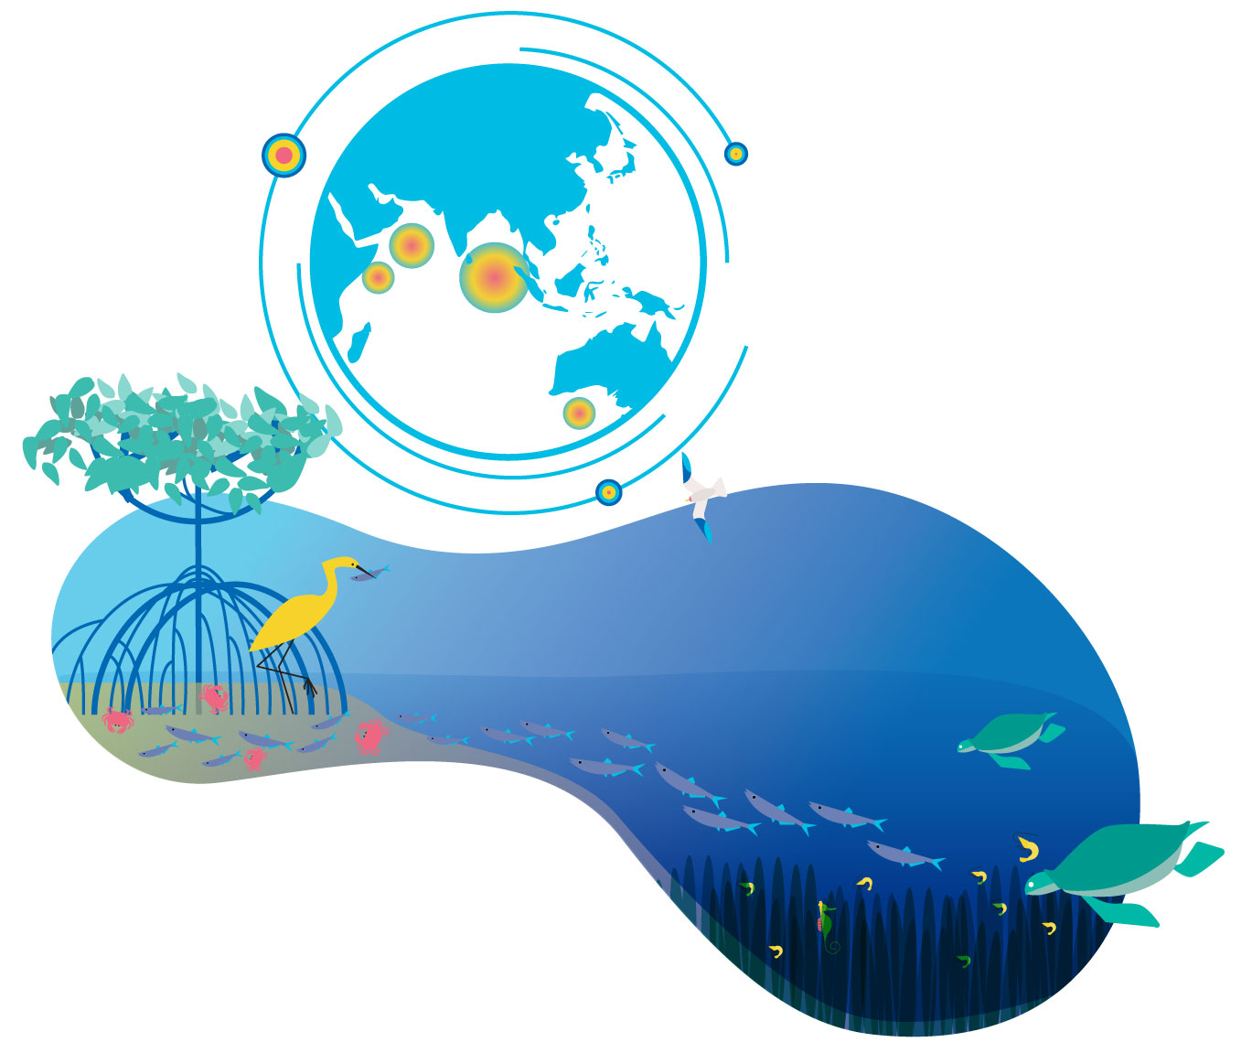
From Nature to Numbers
Habitat data
represents data about biological as well as habitat and geographic diversity.
Notes:
Recently OBIS has taken on data on HABITATS, such as live coral cover, and seagrass meadows. These habitat ecosystems are often near the coast, providing and supporting key ecological services but are under increased stress from human activities. Monitoring the status and change of key habitats is one of the priorities of the Global Ocean Observing System.

Slide 19
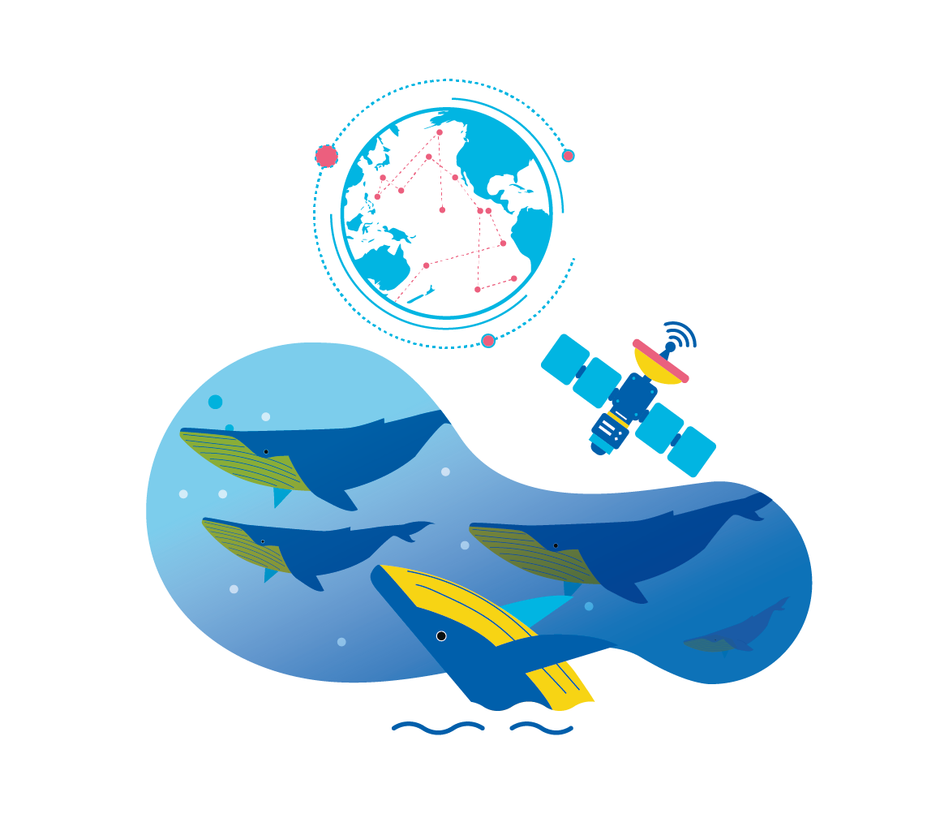
From Nature to Numbers
Tracking data
represents movement data that follows animals via satellites or bioacoustics.
Notes:
Also recent additions to OBIS are TRACKING DATA from tagged animals that are tracked via satelites or acoustic receivers. Animal tracking helps us understand the dynamics of animal movements, discover migration pathways and connectivity between areas, which is important information for more effective conservation and management.

Slide 20
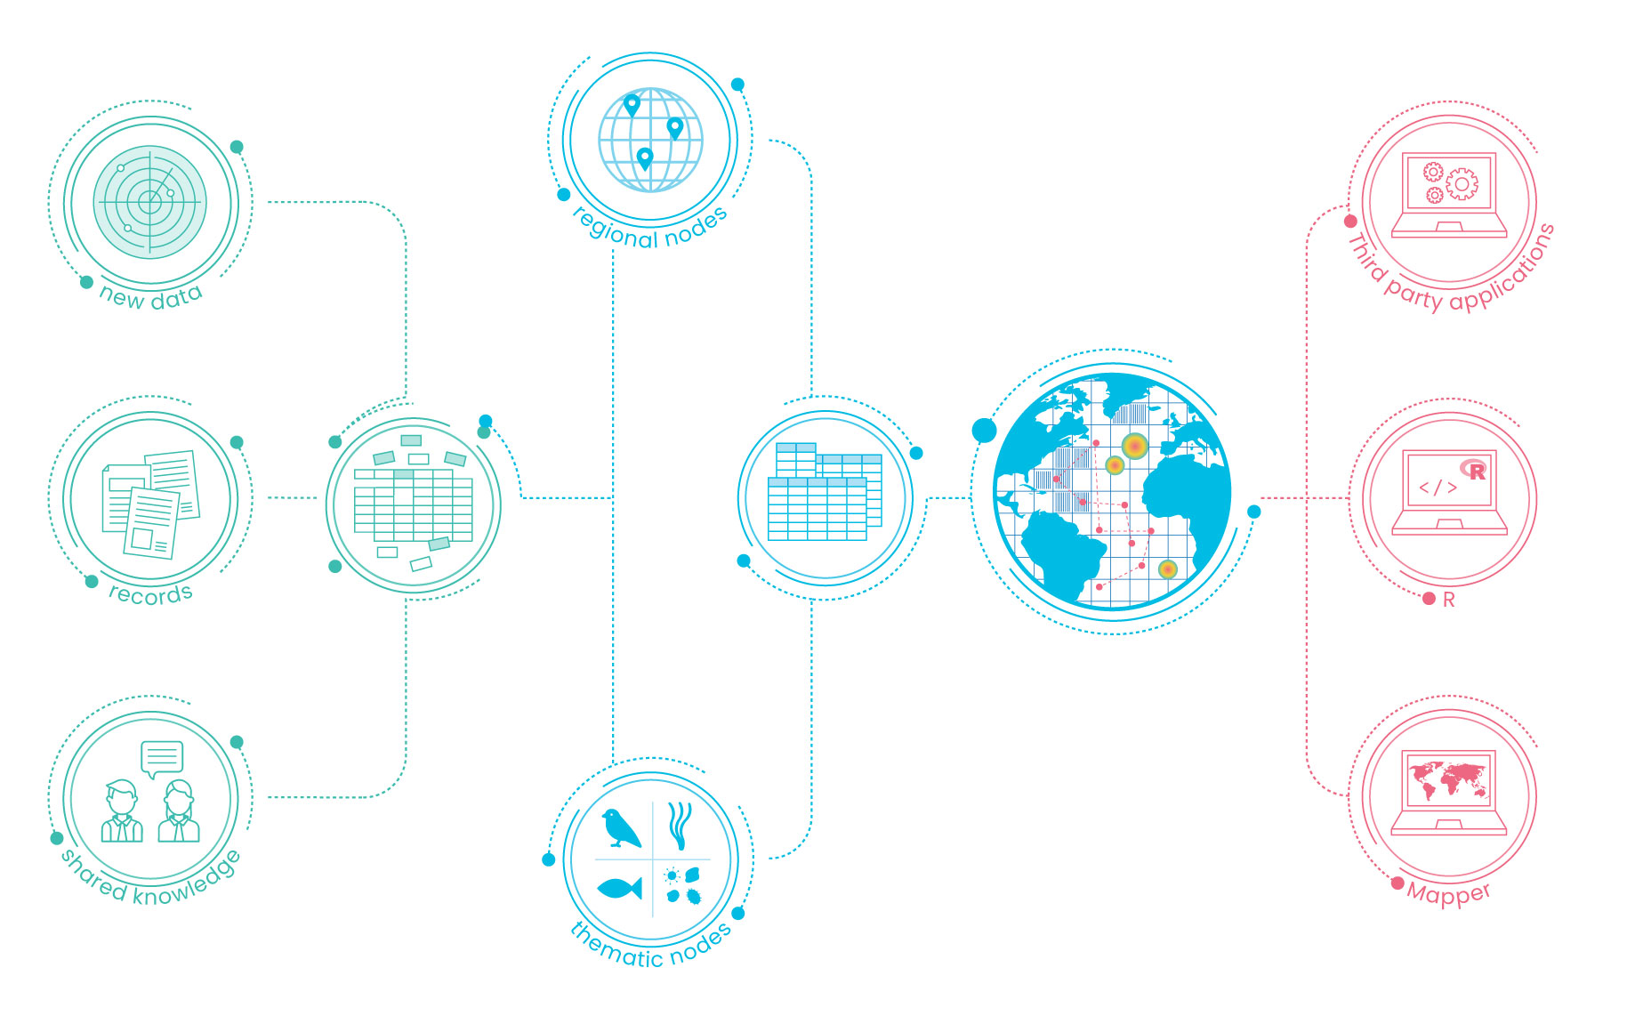
OBIS Data life cycle
Collection:
Integration:
Publication:
Notes:
So we’re going to spend some time this week walking through the data pipeline that builds OBIS’s biodiversity database. It all starts with the over 1,000 data providers or data stewards who are willing to publish the data in the public domain. [click] The data is standardized and quality controlled at the 31 regional or thematic OBIS nodes, after which the central system harvests it, performs an extra QC step and publishes the integrated set. [click] The API webservice powers the OBIS mapper, R package and third party applications, where data can be discovered and downloaded free of charge. Let’s break it down even more.

Slide 21
OBIS
Data life cycle
Collection:
Data is compiled from multiple observations
Notes:
Much of the future of scientific discovery, conservation management and policy will rely on making sense of existent data in connection with novel findings. With this in mind OBIS was founded as an holistic reservoir of ocean biodiversity and biogeographic data.

Slide 22
OBIS
Data life cycle
Integration:
During the standardisation process the OBIS thematic and regional nodes check data quality and apply Darwin Core Standards
Notes:
Before contributing data to the OBIS archive, the network of regional and thematic OBIS nodes execute stringent quality checks, such as validating accurate scientific nomenclature, and transform the data to meet Darwin Core standards, attaching metadata to improve discoverability and suitability for new purposes, to ultimately, magnify the utility of all available data.

Slide 23
OBIS
Data life cycle
Contribution:
The data is then deposited in the OBIS database and made accessible to everyone
The OBIS database follows FAIR guiding principles of scientific data management and stewardship
Notes:
Open-access to standardized and enriched data follows the FAIR principle of scientific data: findable, accessible, interoperable and reusable. Moreover, the inclusion of event-based data, such as details about sampling method, adds contextual depth to OBIS data sets.

Slide 24
OBIS
Data life cycle
Access:
Mapper on OBIS server
R (analytical platform) & robis package
Third party application
Notes:
Data stored on the OBIS database can be accessed via the online Mapper, the R package robis or third party applications powered by the OBIS API webservice.

Slide 25


Capacity Development
OBIS
Data life cycle
Build, improve and retain skills
Notes:
Capacity development is an essential activity for OBIS. And so here we are! So far OBIS has trained more than 300 people from 71 countries in 23 training courses. These training courses are organized in partnership with networks such as EMODNet in Europe and MBON in the US, and with this very course. Our training courses are hosted and available via the e-learning platform of the OceanTeacher Global Academy. For this particular course, we will be iterating on it two more times before the final versions of things are published to OTGA. Trainees are trained in applying the Darwin Core standards, using our QC tools, publishing the data and doing analysis on the data.

Slide 26
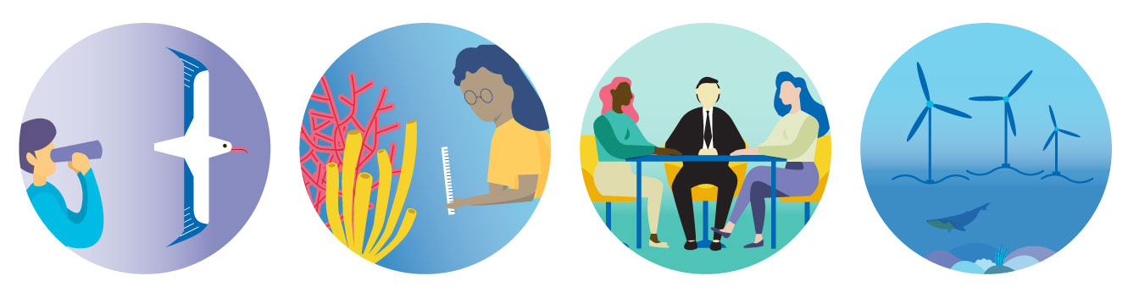
OBIS CASE STUDIES
Notes:
The application of OBIS data ranges from scientific research and conservation management to impact assessments and ocean governance. This is one of the big success metrics for OBIS, how often and to what purposes the data found in OBIS are reused and recycled to support new academic publishing and policymaking.
More than 1,500 publications have cited OBIS so far, of which several are high impact papers and more and more of them are reporting on important global-scale environmental policy concerns such as the impact of climate change.

Slide 27
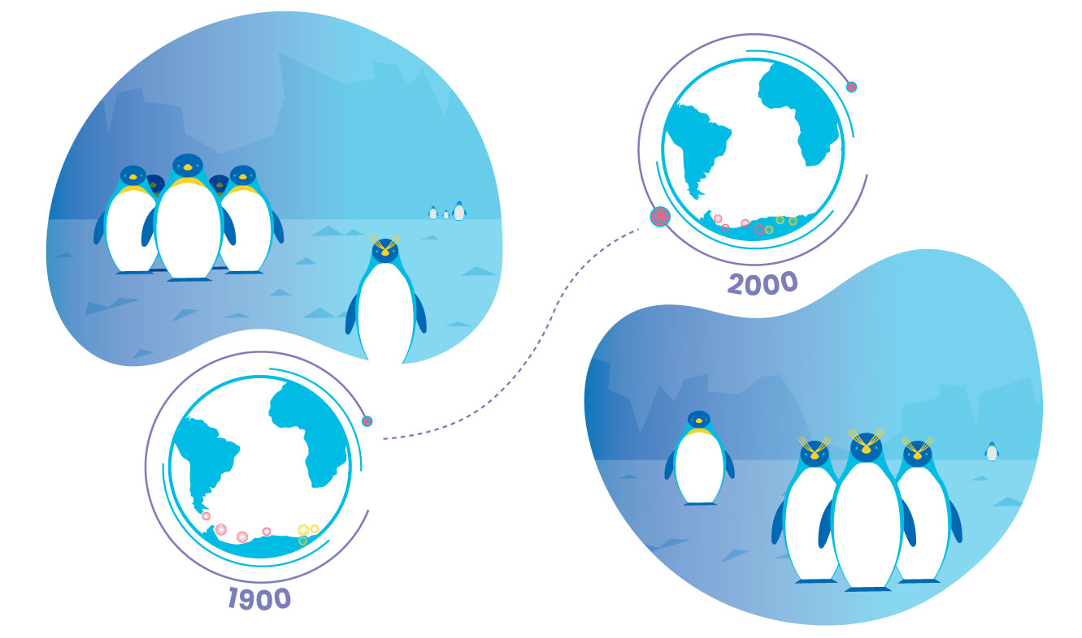

Use cases: Climate
and Biodiversity research
“OBIS is really good at establishing trust with who collects the data and giving credit to scientists generating data. They magnify the effect of each contributor so that each scientist is properly acknowledged.”
Maria Dornelas
University of St. Andrews, UK
Climate change has altered the distribution ranges of marine species
More at https://obis.org/usecases/
DOI: 10.1126/science.1248484
Notes:
Such as this 2014 Science paper from Maria Dornelas. The analysis showed that climate change shrank, widened and overall altered species ranges, permanently transforming communities.

Slide 28
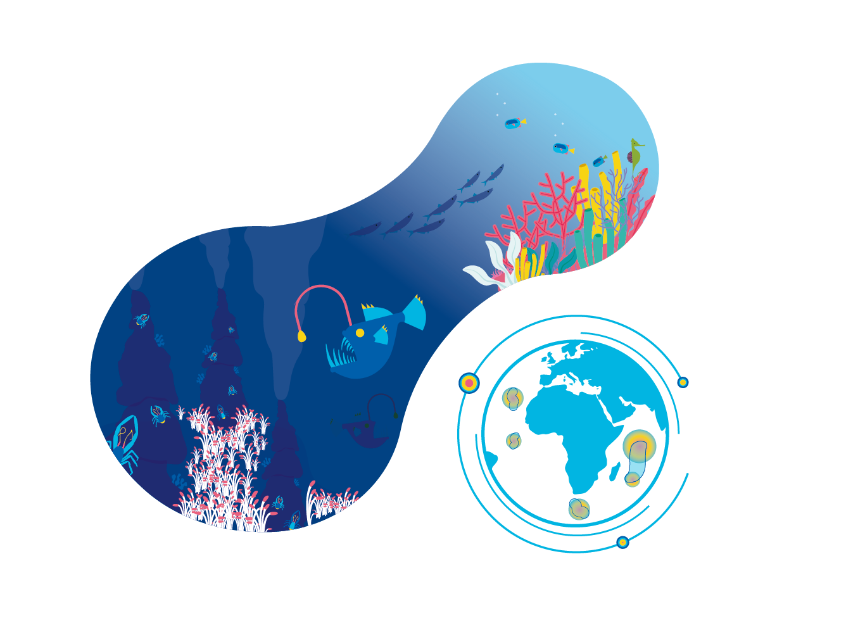

Use cases: Conservation of Ecologically Significant Areas
“I have used OBIS data multiple times.
It is marvelous.
The standardisation by OBIS nodes makes data comparable and adds real value and depth to our research.”
Mark Costello
University of Auckland, New Zealand
Combining OBIS data on species diversity, richness and endemicity, with environmental data, researchers identified 30% of the ocean area as having immediate concern for conservation.
DOI: 10.1016/j.cub.2017.04.060
Notes:
Or this work led by Mark Costello which identified 30% of the ocean that is of immediate conservation concern responding to a call from the International Union for Conservation of Nature (IUCN) to protect 30% of the ocean.

Slide 29
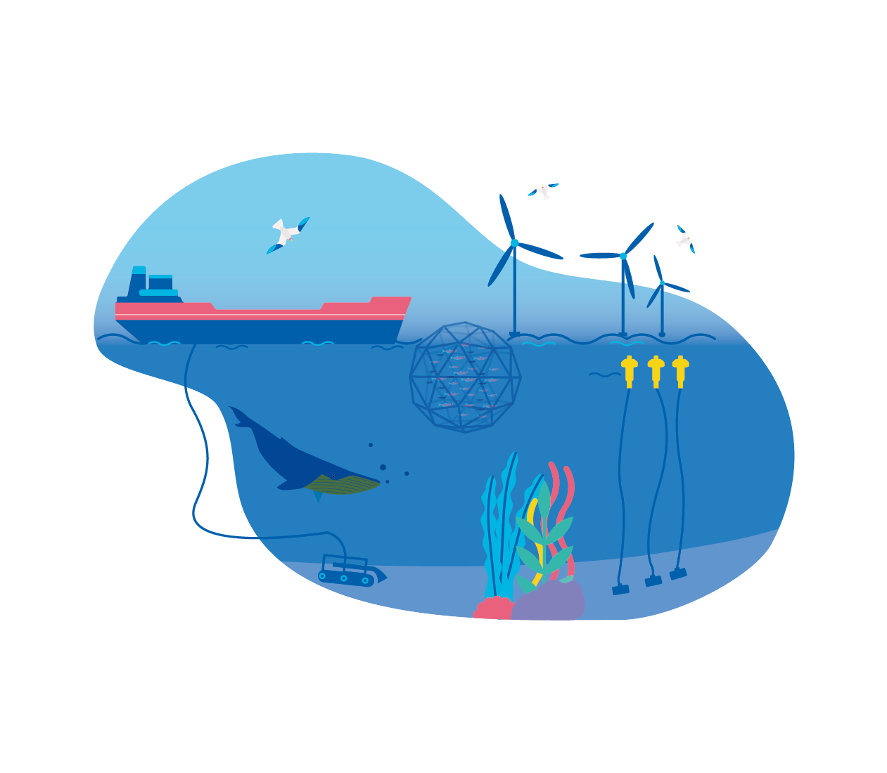
Use cases: Private Sector Usage
Ecological impact assessments are now essential to unite economic considerations with ecological concerns
More at https://obis.org/usecases/
Notes:
Beyond academic publishing, OBIS data is regularly recommended as a trusted source and is used for environmental impact assessments, such as for the safe extraction of valuable resources via mining or the exploitation of wave and wind energy.

Slide 30

Use cases: Regional
and Global Ocean Governance
“Sharing of knowledge
(e.g., OBIS) and open access to information and data streams, particularly across sectors, should be encouraged in order to ensure that the data collected are made available to all.”
2nd UN World Ocean Assessment
Regional and global policies base their decisions either directly on OBIS data or on research, which employs OBIS data.
More at https://obis.org/usecases/
Notes:
The future of data-driven policy making will rely on good data and sharing of information (“collect once, use many times” principle). The standardised and historic data compiled in OBIS for instance allows to improve country statistics for reporting on the state of the environment. The UN World Ocean Assessment and global and regional assessments under the Intergovernmental Platform on Biodiversity and Ecosystem Services use and recommed OBIS as a trusted source.
Ultimately, free access to data removes historic barriers of inequality and allows everyone to tackle marine concerns based on the best information available.

Slide 31
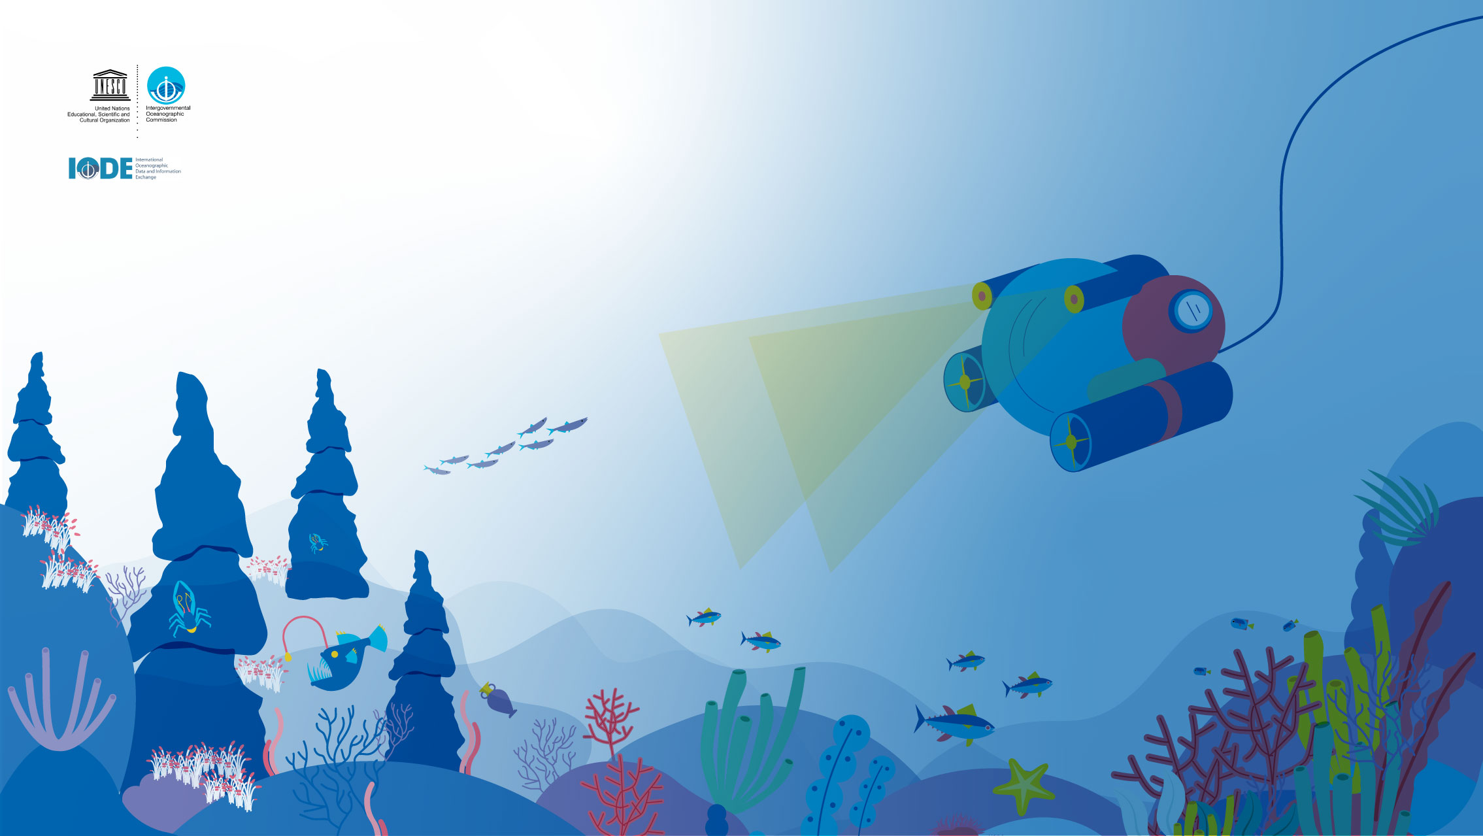
Thanks
Notes:
OBIS never misses an opportunity to thank to all the supporters, donors and the thousands of scientists and the hundreds of data managers who have been involved and contributed to OBIS. Without their efforts we would not have this fantastic resource to use today and in the future by our children.

Slide 32





@oceantrackingnetwork
@oceantracking
oceantrackingnetwork.org

